Slide 1
Unit No: 2
COMBINATIONAL CIRCUITS
Notes:
Unit I:Introduction to Software Engineering, Software Process Models

Slide 2
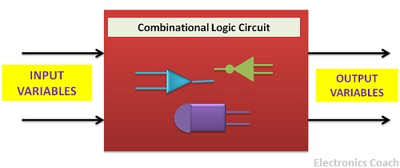
COMBINATIONAL CIRCUITS
The combinational logic circuit comprises of logic gates and thus the output obtained is directly related to the input.
The word combinational is derived from the word combination which means two or more elements combined together by means of single operation.
Reference:Electronics Coach

Slide 3
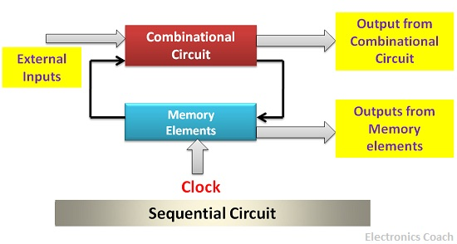
Sequential Logic Circuit
The sequential logic circuit also involves memory elements along with the logic gates. Thus, the output generated by the sequential circuit depends not only on the present state of the input but also on the previous outputs.
Reference:Electronics Coach

Slide 4
COMBINATIONAL CIRCUITS
Introduction
Design Methods
Half Adder
Full Adder
Half Subtractor
Full Subtractor
Code converter
Look-Ahead Carry Adder
BCD Adder

Slide 5
INTRODUCTION
Two classes of logic circuits
  Combinational
  Sequential
Combinational Circuit
  Each output depends entirely on the immediate (present) inputs.
Sequential Circuit
  Each output depends on both present inputs and state.
Combinational
Logic
Combinational
Logic
inputs
: :
: :
outputs
inputs
: :
: :
outputs
Memory

Slide 6
DESIGN METHODS
Design methods make use of logic gates and useful function blocks
  These are available as Integrated Circuit (IC) chips.
  Types of IC chips (based on packing density): SSI, MSI, LSI, VLSI, ULSI.
Main objectives of circuit design:
  Reduce cost
  Increase speed
  Design simplicity

Slide 7
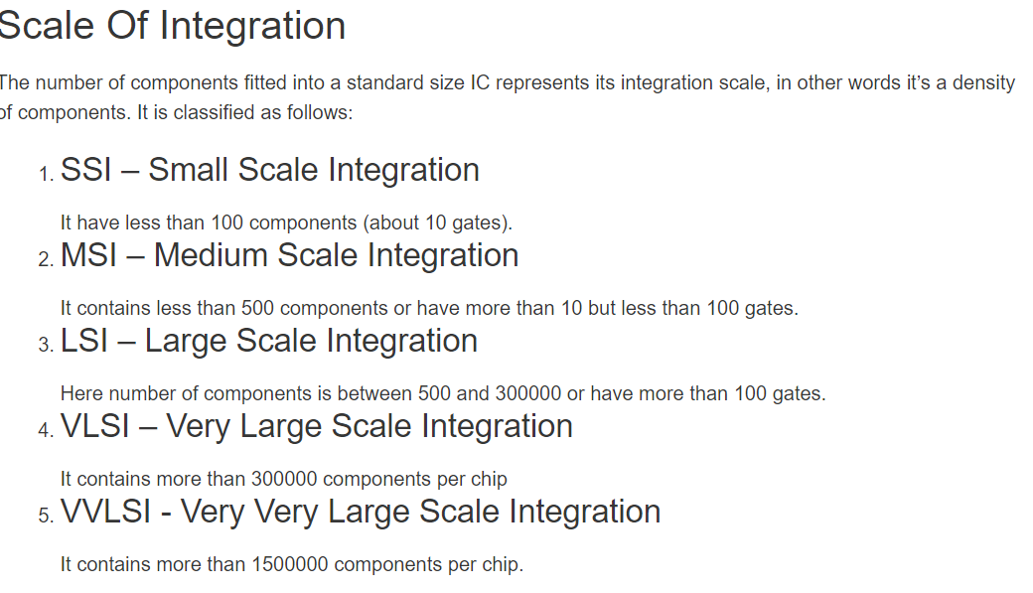
DESIGN METHODS
Design methods make use of logic gates and useful function blocks
  These are available as Integrated Circuit (IC) chips.
  Types of IC chips (based on packing density): SSI, MSI, LSI, VLSI, ULSI.
Reference :https://www.daenotes.com

Slide 8
DESIGN: HALF ADDER
Design procedure:
  1. State problem
  Example: Build a Half Adder.
  2. Determine and label the inputs and outputs of circuit.
  Example: Two inputs and two outputs labelled, as shown below.
X | Y | C | S
0 | 0 | 0 | 0
0 | 1 | 0 | 1
1 | 0 | 0 | 1
1 | 1 | 1 | 0
X
Y
Half
Adder
S
C
(X + Y)
  3. Draw the truth table.

Slide 9
DESIGN: HALF ADDER
  4. Obtain simplified Boolean functions.
  Example: C = X⋅Y
  S = X'⋅Y + X⋅Y' = X⊕Y
X | Y | C | S
0 | 0 | 0 | 0
0 | 1 | 0 | 1
1 | 0 | 0 | 1
1 | 1 | 1 | 0
  5. Draw logic diagram.
X
Y
S
Half Adder
C

Slide 10
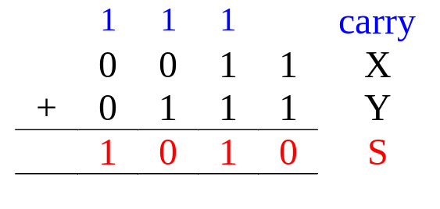
DESIGN: FULL ADDER
Half adder adds up only two bits.
To add two binary numbers(more than 2 bits), we need to add 3 bits (including the carry).
  Example:
Need Full Adder
X
Y
Z
Full
Adder
S
C
(X + Y + Z)

Slide 11
DESIGN: FULL ADDER
Truth table:
X | Y | Z | C | S
0 | 0 | 0 | 0 | 0
0 | 0 | 1 | 0 | 1
0 | 1 | 0 | 0 | 1
0 | 1 | 1 | 1 | 0
1 | 0 | 0 | 0 | 1
1 | 0 | 1 | 1 | 0
1 | 1 | 0 | 1 | 0
1 | 1 | 1 | 1 | 1
Note:
Z - carry in (to the current position)
C - carry out (to the next position)
C
YZ
00 01 11 10
X
0
1
1
1
1
1
Using K-map, simplified SOP form:
  C = ?
  S = ?
S
YZ
00 01 11 10
X
0
1
1
1
1
1


Slide 12
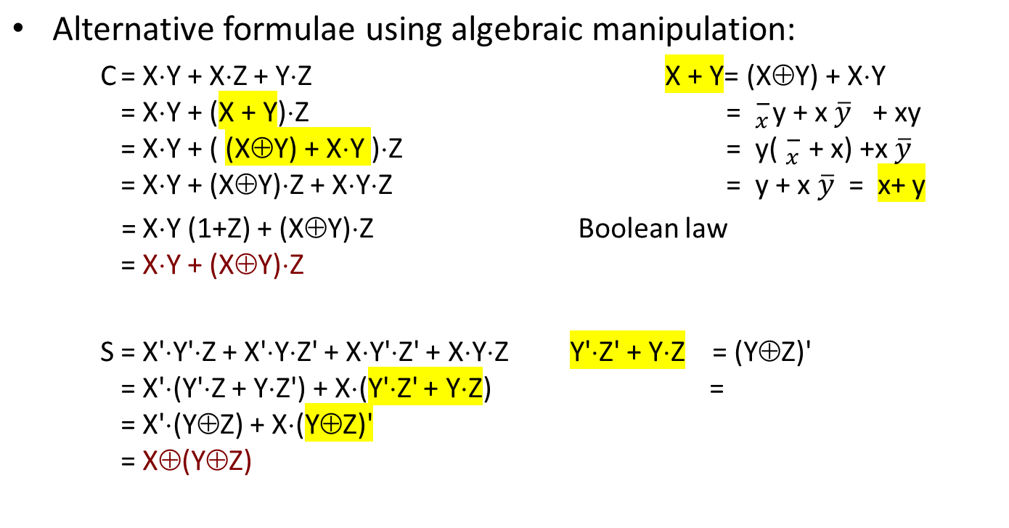
DESIGN: FULL ADDER

Slide 13
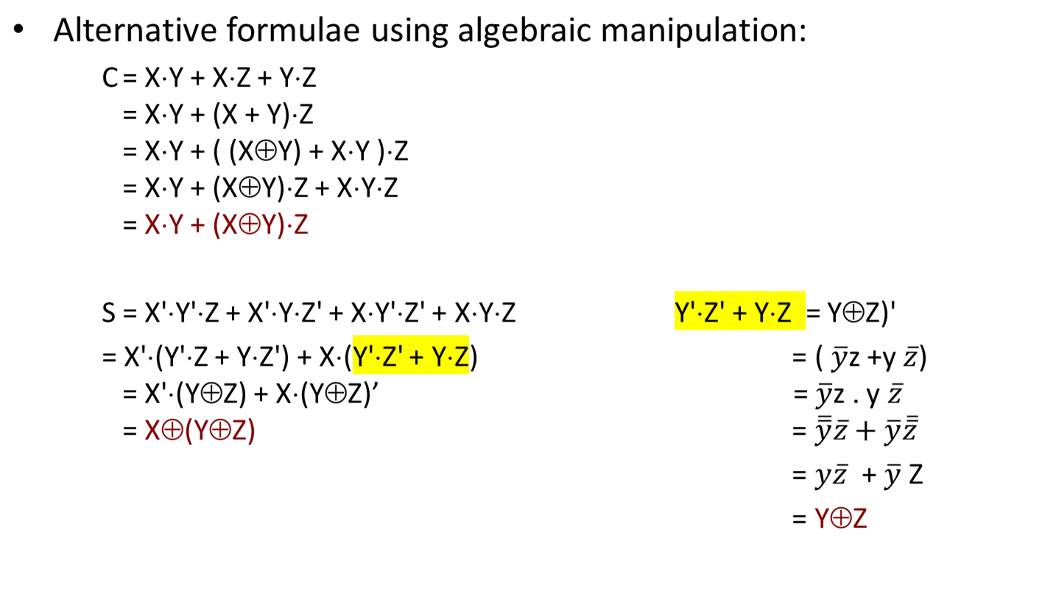
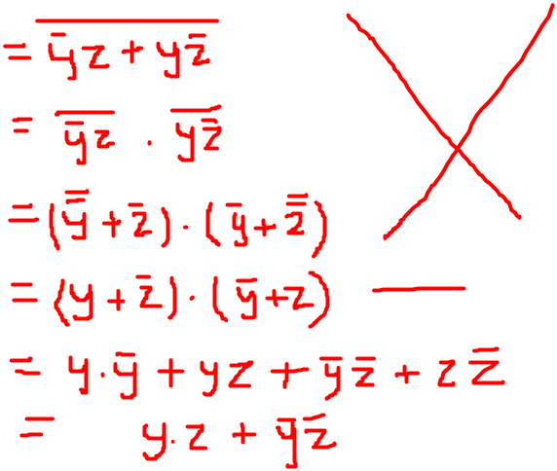
DESIGN: FULL ADDER

Slide 14
DESIGN: FULL ADDER
Circuit for above formulae:
  C = X⋅Y + (X⊕Y)⋅Z
  S = X⊕(Y⊕Z)
X
Y
(X⊕Y)
S
(X⋅Y)
C
Z
Full Adder made from two Half-Adders (+ an OR gate).

Slide 15
DESIGN: FULL ADDER
Circuit for above formulae:
  C = X⋅Y + (X⊕Y)⋅Z
  S = X⊕(Y⊕Z)
Block diagrams.
X
Y
X
Y
(X⊕Y)
Sum
X
Y
Sum
S
Half
Adder
Half
Adder
Carry
(X⋅Y)
Carry
C
Z
Full Adder made from two Half-Adders (+ an OR gate).

Slide 16
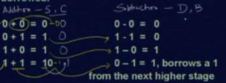
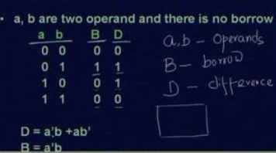
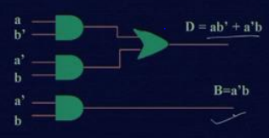
DESIGN: HALF SUBTRACTOR
Subtraction can be performed similarly using binary numbers.
Types: Half Subtractor
Full Subtractor
Half Subtractor
  a half subtractor is a combination circuit; that subtracts two bits and produces the difference
  Reference: NPTEL

Slide 17
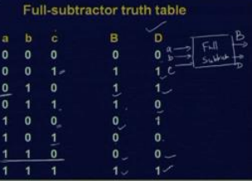
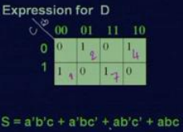
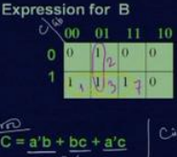
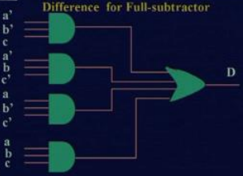
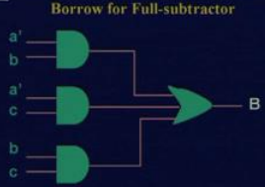
DESIGN: FULL SUBTRACTOR using Basic GATES
Full Subtractor
  a combinational circuit that performs the subtraction between two bits, A 1 may have been borrowed by a lower significant stage.
  A full subtractor circuit accepts a minuend (A) and the subtrahend (B) and a borrow (BIN) as inputs from a previous circuit.
  A full subtractor circuit can be realized by combining two half subtractor circuits and an OR gate.
  Reference: NPTEL

Slide 18
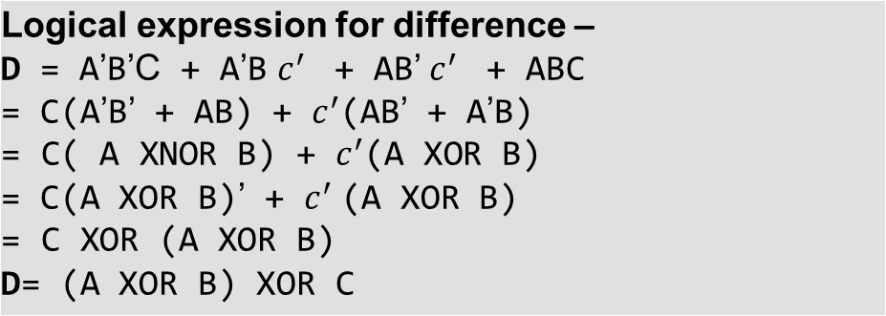
Full Subtractor using Universal Gates
Logical expression for borrow –
BORROW = A’C + A’B + BC
OR BORROW = A’B’C + A’BC’ + A’BC + ABC
= C(AB + A’B’) + A’B(C + C’)
= C( A XNOR B) + A’B
= C (A XOR B)’ + A’B

Slide 19
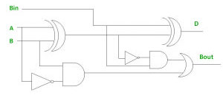
Reference :www.geeksforgeeks.org
D= (A XOR B) XOR C
BORROW= C (A XOR B)’ + A’B
C
BORROW

Slide 20
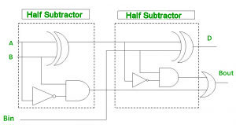
Implementation of Full Subtractor using Half Subtractors –
2 Half Subtractors and an OR gate is required to implement a Full Subtractor.
Reference :www.geeksforgeeks.org

Slide 21
CODE CONVERTERS
Code converter – takes an input code, translates to its equivalent output code.
Input
code
Code
converter
Output
code
Example: Binary to Gray code converter
  Input: Binary
  Output: Gray
Gray to Binary
  Input: Gray
  Output: Binary
BCD to Excess-3 code converter.
  Input: BCD code
  Output: Excess-3 code

Slide 22
BINARY TO GRAY & GRAY TO BINARY
The reflected binary code or Gray code is an ordering of the binary numeral system such that two successive values differ in only one bit (binary digit). Gray codes are very useful in the normal sequence of binary numbers generated by the hardware that may cause an error or ambiguity during the transition from one number to the next. So, the Gray code can eliminate this problem easily since only one bit changes its value during any transition between two numbers.
Gray codes are used in rotary and optical encoders, Karnaugh maps, and error detection.

Slide 23
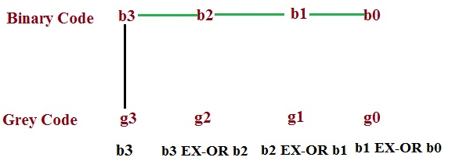
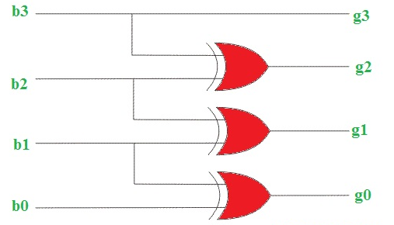
BINARY TO GRAY & GRAY TO BINARY
Binary to Gray
  Record the most significant bit as it is.
  EX-OR this bit to the next position bit, record the resultant bit.
  Record successive EX-ORed bits until completed.
  Convert 0011 binary to Gray.
g3 = b3
g2 = b3 xor b2
g1 = b2 xor b1
g0 = b1 xor b0

Slide 24
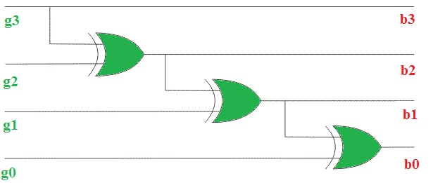
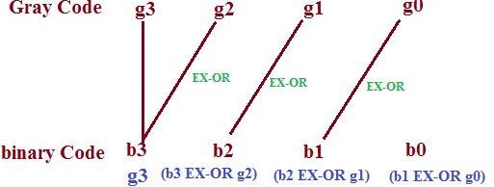
BINARY TO GRAY & GRAY TO BINARY
Gray to Binary
The Gray code can be converted to binary by a reverse process.
Record the most significant bit as it is.
EX-OR binary MSB to the next bit of Gray code and record the resultant bit.
Continue the process until the LSB is recorded.
Convert 1011 Gray to Binary code.
Equations Are:
b3 = g3
b2 = g3 xor g2 or b3 xor g2
b1 = g3 xor g2 xor g1 or b2 xor g1
b0 = g3 xor g2 xor g1 xor g0 or b1 xor g0
Reference: Tutorials Point

Slide 25
BINARY TO GRAY & GRAY TO BINARY
Decimal | Binary | Gray Code
0 | 000 | 000
1 | 001 | 001
2 | 010 | 011
3 | 011 | 010
4 | 100 | 110
5 | 101 | 111
6 | 110 | 101
7 | 111 | 100
Convert Binary number 111011 into Gray code.

Slide 26
BCD-TO-EXCESS-3 Code CONVERTER
The excess-3 code (or XS3) is a non-weighted code used to express decimal numbers. It is a self-complementary binary coded decimal (BCD) code
It is particularly significant for arithmetic operations as it overcomes shortcoming encountered while using 8421 BCD code to add two decimal digits whose sum exceeds 9.
Excess-3 arithmetic uses different algorithm than normal non-biased BCD.
Self-complementary property
Excess-3 code is non-weighted and self complementary code. A self complementary binary codes are always compliment themselves. The complement of a binary number can be obtained from that number by replacing 0’s with 1’s and 1’s with 0’s. The sum of binary number and its complement is always equal to decimal 9. In other words, the 1’s complement of an excess-3 code is the excess-3 code for the 9’s complement of the corresponding decimal number.
For example, the excess-3 code for decimal number 5 is 1000 and 1’s complement of 1000 is 0111, which is excess-3 code for decimal number 4, and it is 9’s complement of number 5.

Slide 27




BCD-TO-EXCESS-3 CONVERTER
Truth table:
K-maps:
 | BCD |  |  |  | Excess-3
 | A | B | C | D | W | X | Y | Z
0 | 0 | 0 | 0 | 0 | 0 | 0 | 1 | 1
1 | 0 | 0 | 0 | 1 | 0 | 1 | 0 | 0
2 | 0 | 0 | 1 | 0 | 0 | 1 | 0 | 1
3 | 0 | 0 | 1 | 1 | 0 | 1 | 1 | 0
4 | 0 | 1 | 0 | 0 | 0 | 1 | 1 | 1
5 | 0 | 1 | 0 | 1 | 1 | 0 | 0 | 0
6 | 0 | 1 | 1 | 0 | 1 | 0 | 0 | 1
7 | 0 | 1 | 1 | 1 | 1 | 0 | 1 | 0
8 | 1 | 0 | 0 | 0 | 1 | 0 | 1 | 1
9 | 1 | 0 | 0 | 1 | 1 | 1 | 0 | 0
10 | 1 | 0 | 1 | 0 | X | X | X | X
11 | 1 | 0 | 1 | 1 | X | X | X | X
12 | 1 | 1 | 0 | 0 | X | X | X | X
13 | 1 | 1 | 0 | 1 | X | X | X | X
14 | 1 | 1 | 1 | 0 | X | X | X | X
15 | 1 | 1 | 1 | 1 | X | X | X | X
CD
C
CD
C
AB
00 01 11 10
AB
00 01 11 10
00
01
11
10
00
01
11
10
1
1
1
1
1
1
1
B
B
A
X
X
X
X
A
X
X
X
X
1
1
X
X
1
X
X
W
D
D
CD
C
CD
C
AB
00 01 11 10
AB
00 01 11 10
00
01
11
10
1
1
00
01
11
10
1
1
1
1
1
1
B
B
A
X
X
X
X
A
X
X
X
X
1
X
X
1
X
X
D
D
Reference:Digital Design,
5th edition by Morris Mano and Michael Ciletti

Slide 28
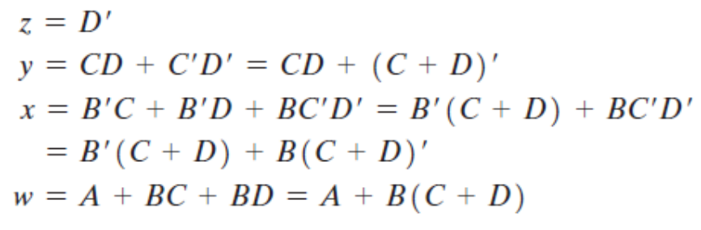
BCD-TO-EXCESS-3 CONVERTER
CD
C
CD
C
AB
00 01 11 10
AB
00 01 11 10
00
01
11
10
00
01
11
10
1
1
1
1
1
1
1
B
B
A
X
X
X
X
A
X
X
X
X
1
1
X
X
1
X
X
W
D
X
D
CD
C
CD
C
AB
00 01 11 10
AB
00 01 11 10
00
01
11
10
1
1
00
01
11
10
1
1
1
1
1
1
B
B
A
X
X
X
X
A
X
X
X
X
1
X
X
1
X
X
Y
D
Z
D

Digital Design,
5th edition by Morris Mano and Michael Ciletti

Slide 29
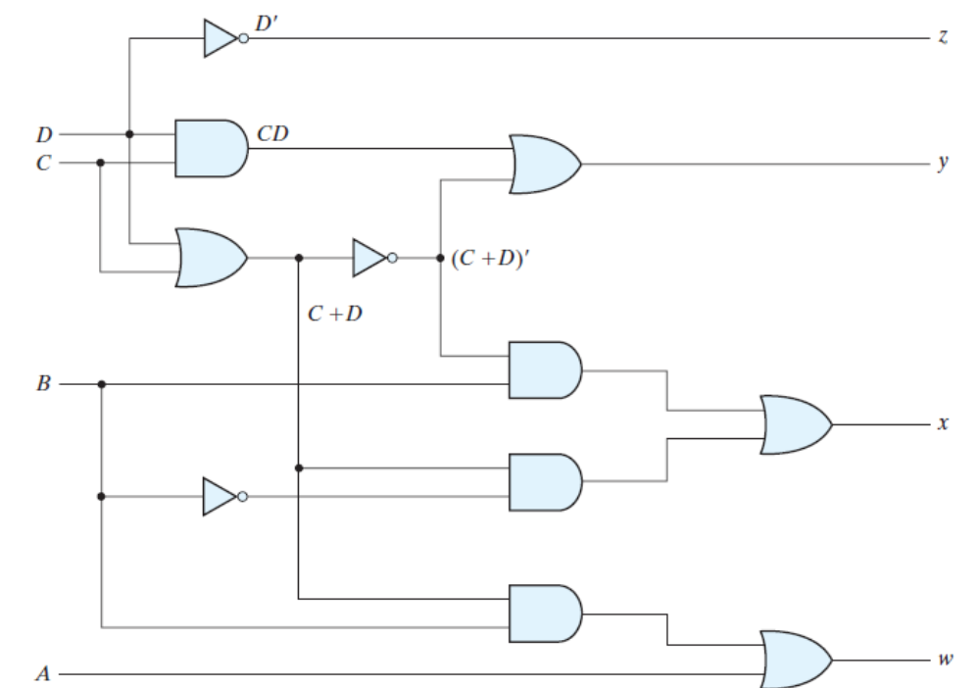
Digital Design,
5th edition by Morris Mano and Michael Ciletti

Slide 30
Convert decimal number 23 to Excess-3 code.
So, according to excess-3 code we need to add 3 to both digit in the decimal number then convert into 4-bit binary number for result of each digit.
Therefore, = 23+33=56 =0101 0110 which is required excess-3 code for given decimal number 23.
Convert decimal number 15.46 into Excess-3 code.
According to excess-3 code we need to add 3 to both digit in the decimal number then convert into 4-bit binary number for result of each digit.
Therefore,= 15.46+33.33=48.79 =0100 1000.0111 1001 which is required excess-3 code for given decimal number 15.46.

Slide 31
Converting into Binary Coded Decimal (BCD) codes from Excess3 code
One should note that to given Excess-3 code, the equivalent decimal number can be determined by splitting number into 4-bit group starting from least significant for integer part and from leftmost digit for fractional part. Then subtract 0011 (=3) from each four-bit group that will be binary decimal digit (BCD) form of that number. Now you can also convert this BCD code into decimal number by converting each 4-bit group into decimal digit.
Example − Convert Excess-3 code 1001001 into BCD and decimal number.
So, grouping 4-bit for each group, i.e., 0100 1001 and subtract 0011 0011 from given number. Therefore,= 0100 1001 -0011 0011 =0001 0110
So, binary coded decimal number is 0001 0110 and decimal number will be 16.

Slide 32
Advantages of Excess-3 Codes
These are unweighted binary decimal codes.
These are self-complementary codes.
The codes 0000 and 1111 are not used for any digit which is an advantage for memory organization as these codes can cause fault in transmission line.
It has no limitation, and it considerably simplifies arithmetic operations.
It is particularly significant for arithmetic operations as it overcomes shortcoming encountered while using 8421 BCD code to add two decimal digits whose sum exceeds 9.

Slide 33
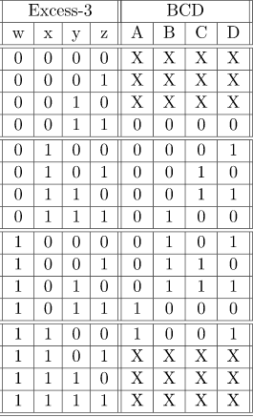
Converting Excess-3 to BCD(8421) –
Excess-3 code can be converted back to BCD in the same manner.

Slide 34
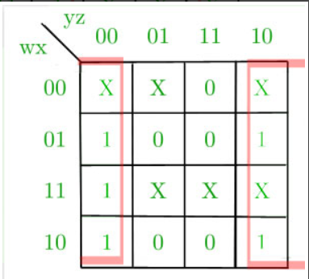
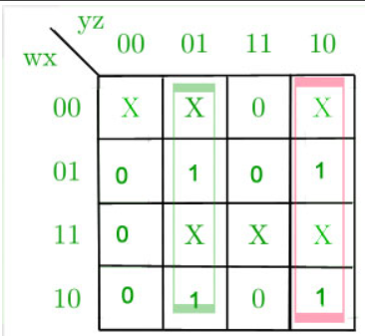
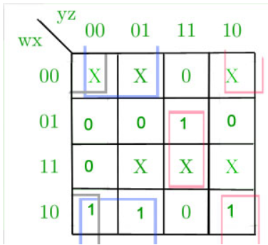
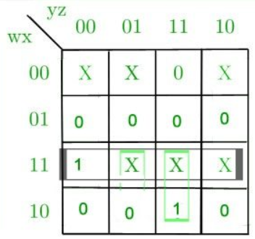
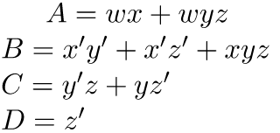
K-Map for D-
K-Map for C-
K-Map for B-
K-Map for A-

Slide 35
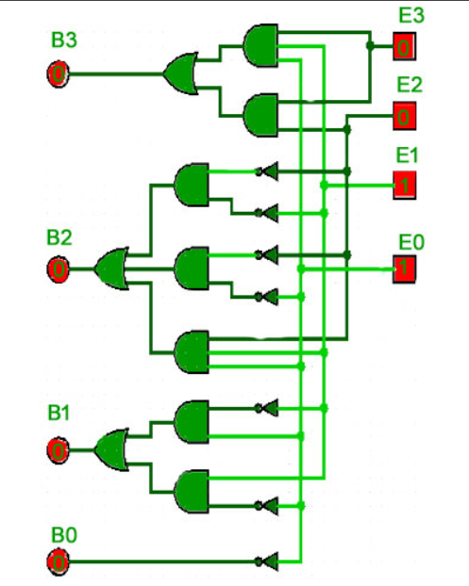
.
Reference:Digital Design, 5th edition by Morris Mano and Michael Ciletti

Slide 36
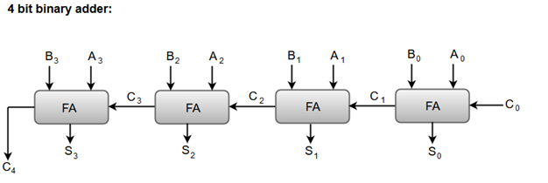
Binary Adder
A Binary Adder is a digital circuit that performs the arithmetic sum of two binary numbers.
A Binary Adder is constructed using full-adder circuits connected in series, with the output carry from one full-adder connected to the input carry of the next full-adder.
Reference:Digital Design, 5th edition by Morris Mano and Michael Ciletti

Slide 37
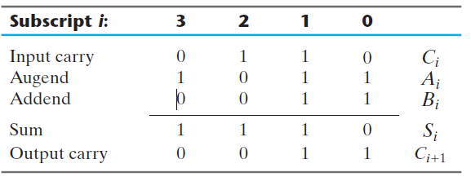
To demonstrate with a specific example, consider the two binary numbers
A = 1011
B = 0011.
Their sum S = 1110 is formed with the four-bit adder as follows:
Reference:Digital Design, 5th edition by Morris Mano and Michael Ciletti

Slide 38
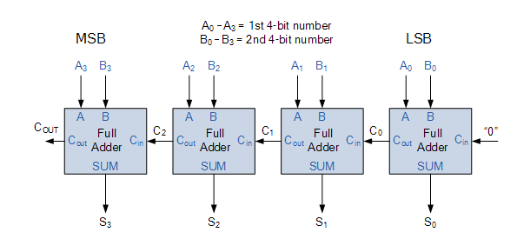
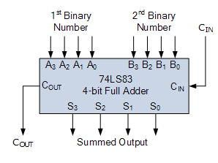
Binary Adder
4-bit ripple carry adder /Binary Adder
Disadvantage: The unwanted delay time occurred is called Propagation delay.

Slide 39
Carry Propagation
The addition of two binary numbers in parallel implies that all the bits of the augend and addend are available for computation at the same time. As in any combinational circuit, the signal must propagate through the gates before the correct output sum is available in the output terminals. The longest propagation delay time in an adder is the time it takes the carry to propagate through the full adders. Since each bit of the sum output depends on the value of the input carry, the value of Si at any given stage in the adder will be in its steady-state final value only after the input carry to that stage has been propagated.
The carry propagation time is an important attribute of the adder because it limits the speed with which two numbers are added. Although the adder—or, for that matter, any combinational circuit—will always have some value at its output terminals, the outputs will not be correct unless the signals are given enough time to propagate through the gates connected from the inputs to the outputs.
An obvious solution for reducing the carry propagation delay time is to employ faster gates with reduced delays. However, physical circuits have a limit to their capability. Another solution is to increase the complexity of the equipment in such a way that the carry delay time is reduced. There are several techniques for reducing the carry propagation time in a parallel adder. The most widely used technique employs the principle of carry lookahead logic .
Reference:Digital Design, 5th edition by Morris Mano and Michael Ciletti

Slide 40
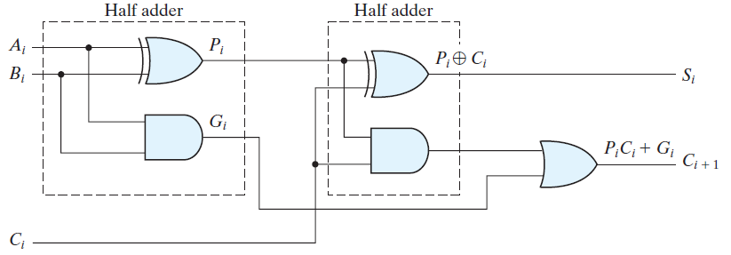
LOOK-AHEAD CARRY ADDER
Consider the Full Adder, where intermediate signals are labelled as P_{i} and G_{i}:
  P_{i} = A_{i} ⊕ B_{i}
  G_{i} = A_{i} ∙B_{i}
The outputs carry and Sum C_{i+1}, S_{i}, in terms of P_{i}, G_{i}, C_{i} are:
  S_{i} = P_{i} ⊕ C_{i} … (1)
  C_{i+1} = G_{i} + P_{i}∙C_{i} … (2)
Looking at equation (2):
Gi = Ai ∙Bi is a carry generate signal,(it produces a carry of 1 when both Ai and Bi are 1,regardless of the input carry Ci.)
P_{i} = A_{i} ⊕ B_{i} is a carry propagate signal. (because it determines whether a carry
into stage i will propagate into stage i + 1 i.e., whether an assertion of
Ci will propagate to an assertion of Ci+1 )
Reference: Digital Design, 5th edition by Morris Mano and Michael Ciletti

Slide 41
LOOK-AHEAD CARRY ADDER
We now write the Boolean functions for the carry outputs of each stage and substitute
the value of each Ci from the previous equations:
C0 = input carry (Always 0)
C1 = G0 + P0C0
C2 = G1 + P1C1
= G1 + P1(G0 + P0C0)
= G1 + P1G0 + P1P0C0
C3 = G2 + P2C2
= G2 + P2(G1 + P1G0 + P1P0C0)
= G2 + P2G1 + P2P1G0 + P2P1P0C0
Reference: Digital Design, 5th edition by Morris Mano and Michael Ciletti

Slide 42
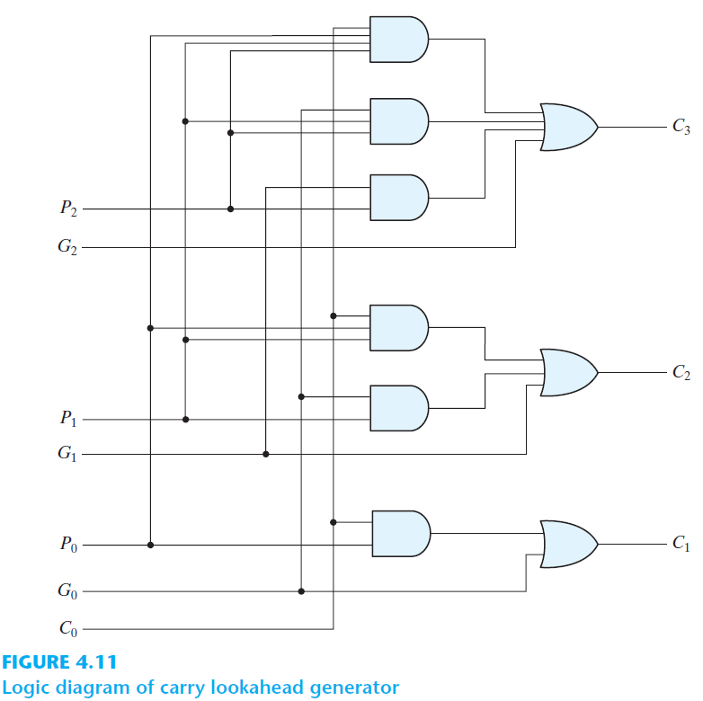
Since the Boolean function for each output carry is expressed in sum-of-products form, each function can be implemented with one level of AND gates followed by an OR gate.
C0=0
C1 = G0 + P0C0
C2= G1 + P1G0 + P1P0C0
C3 = = G2 + P2G1 + P2P1G0 + P2P1P0C0
Note that this circuit can add in less time because C3 does not have to wait for C2 and C1 to propagate; in fact, C3 is propagated at the same time as C1 and C2. This gain in speed of operation is achieved at the expense of additional complexity (hardware).
Reference: Digital Design, 5th edition by Morris Mano and Michael Ciletti

Slide 43
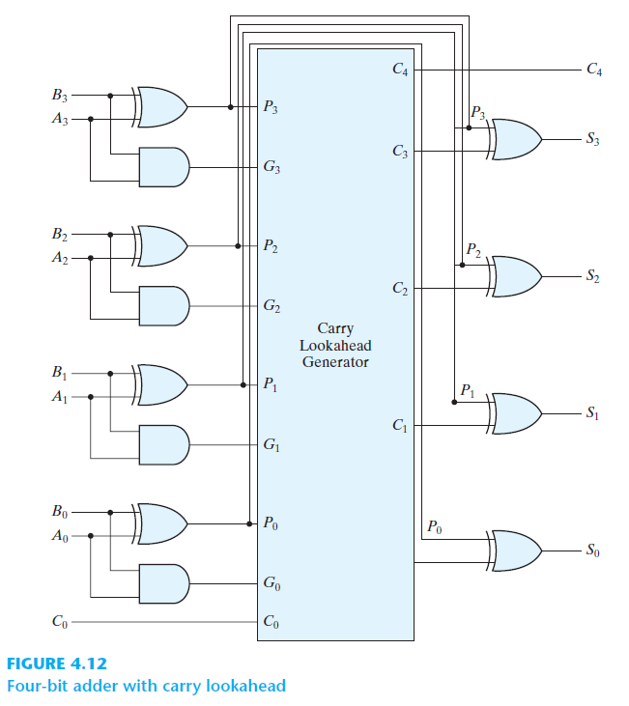
Each sum output requires two exclusive-OR gates. The output of the first exclusive-OR gate generates the Pi variable, and the AND gate generates the Gi variable. The carries are propagated through the carry lookahead generator (similar to that in Fig. 4.11 ) and applied as inputs to the second exclusive-OR gate. All output carries are generated after a delay through two levels of gates. Thus, outputs S1 through S3 have equal propagation delay times. The two-level circuit for the output carry C4 is not shown.

Slide 44
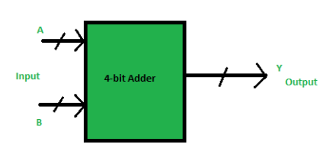
BCD ADDER
Binary Coded Decimal
Consider the arithmetic addition of two decimal digits in BCD, together with an input carry from a previous stage. Since each input digit does not exceed 9, the output sum cannot be greater than 9 + 9 + 1 = 19, the 1 in the sum being an input carry.

Slide 45
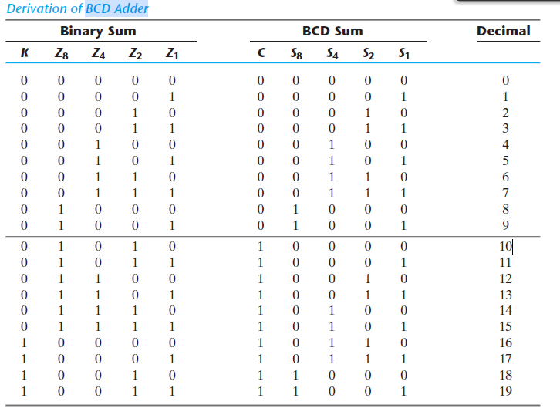

Slide 46



BCD ADDER
The output will varies from 0 to 18, if we are not considering the carry from the previous sum.
But if we are considering the carry, then the maximum value of output will be 19 (i.e. 9+9+1 = 19).
Case: I – Sum <=9, Carry = 0
1:
5:
6: Sum is less than 9. So, valid BCD.
Case:II – Sum >9, Carry = 0
10:
5:
15: Sum is invalid in BCD, as15 – 0001 0101
Add 6
Sum is Valid BCD

Slide 47


BCD ADDER
Case:III – Sum <=9, Carry = 1
9:
9:
Sum is Invalid. BCD 18- 0001 1000
Add 6
Sum is Valid BCD.

Slide 48
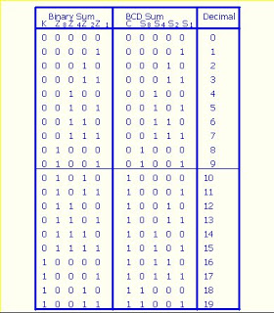
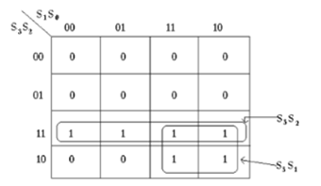
K-Map for C
C = S3.S2 + S3.S1

Slide 49
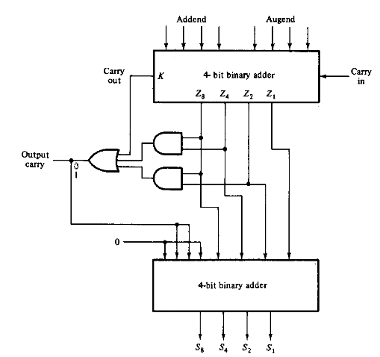
BCD Adder Circuit

